Slide 1
Sizing Of Electric Vehicle Component Using -Dynamic Modeling Approach
Mohan Rajkumar
(MBD Electric Powertrain Researcher)

Slide 2
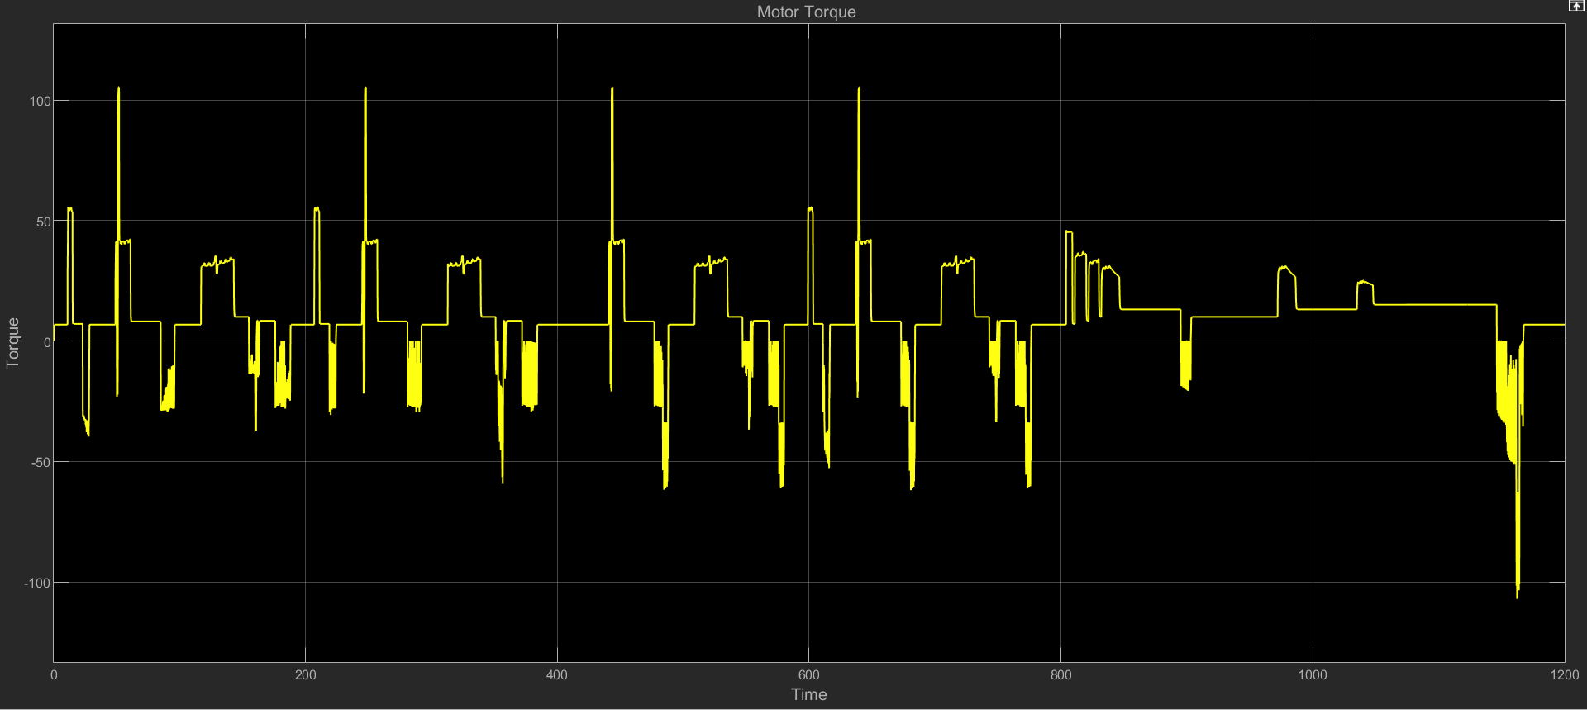
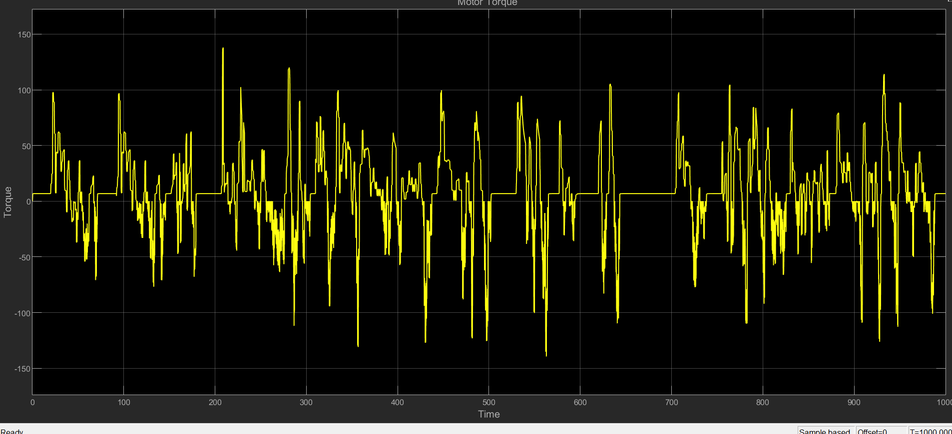
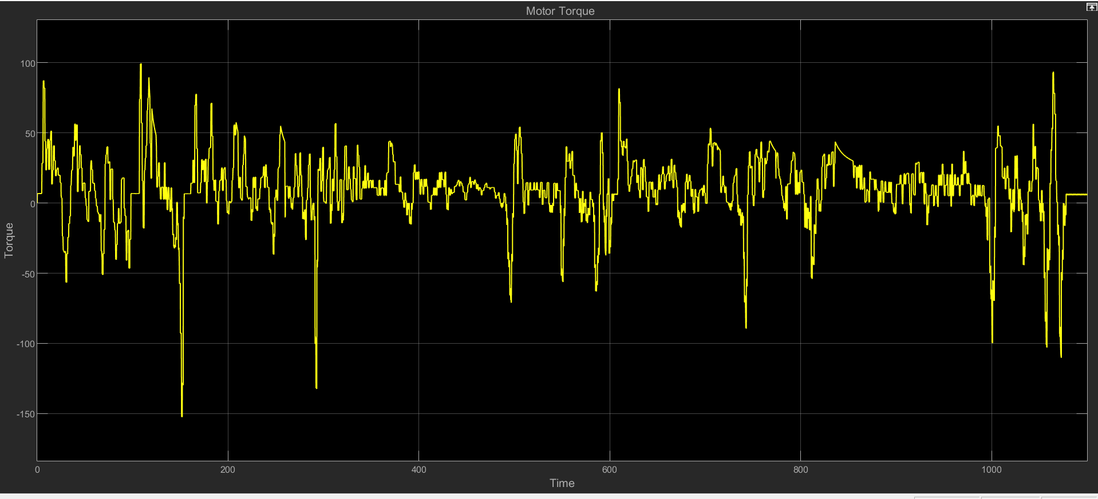
Motor Torque for different drive cycle
NEDC Drive cycle
Urban Drive Cycle
120 Nm
105Nm
Rural Drive Cycle
100Nm

Slide 3
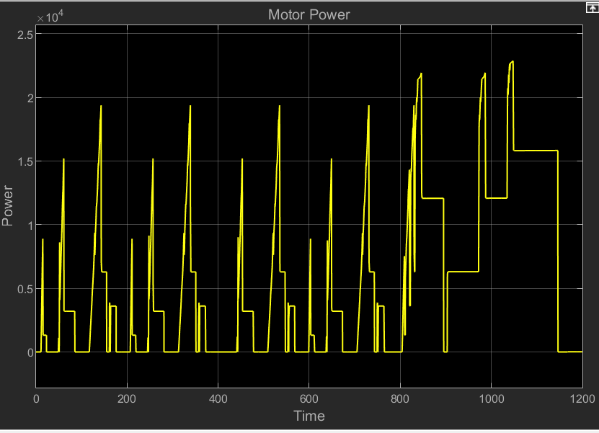
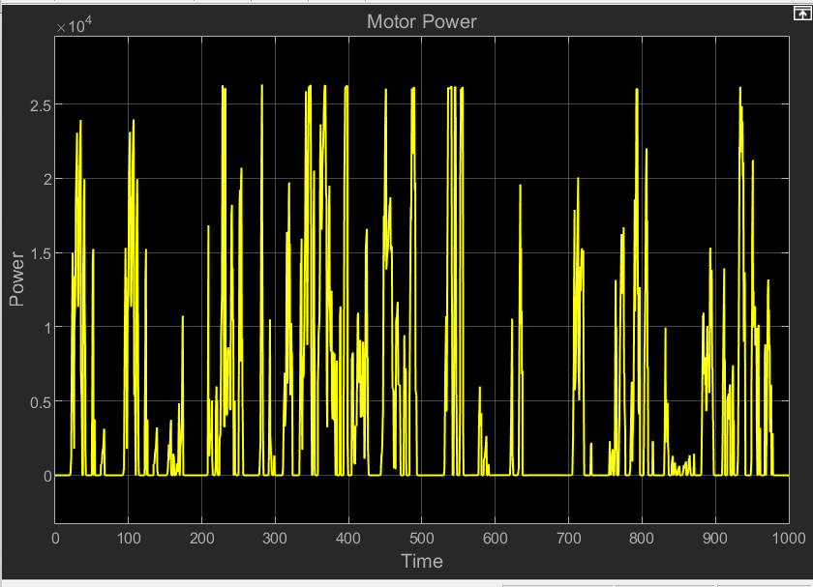
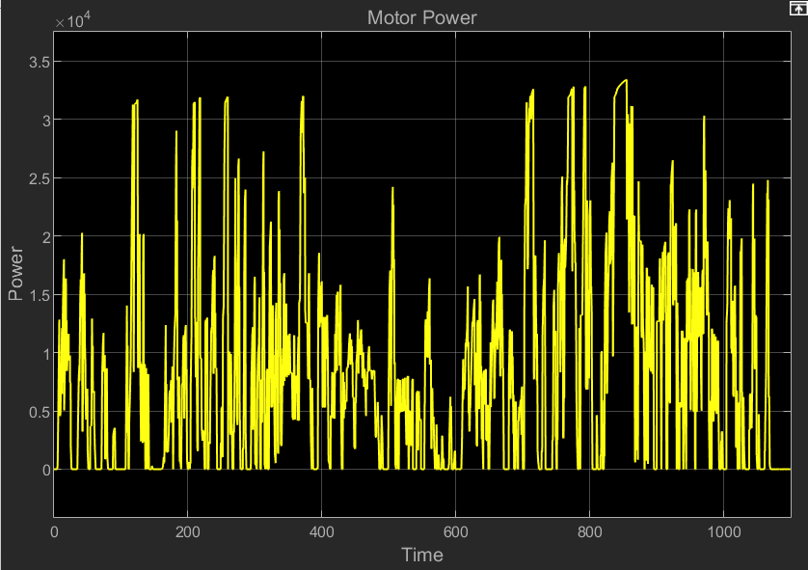
Motor Power for different drive cycle
NEDC Drive cycle
Urban Drive Cycle
Rural Drive Cycle
120 Nm
23000W
26000W
36000W

Slide 4
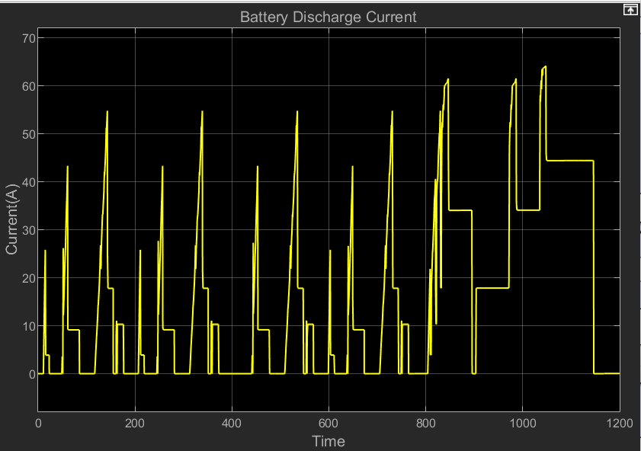
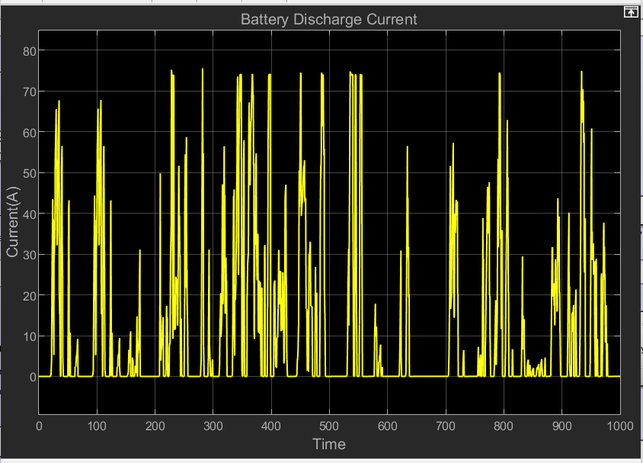
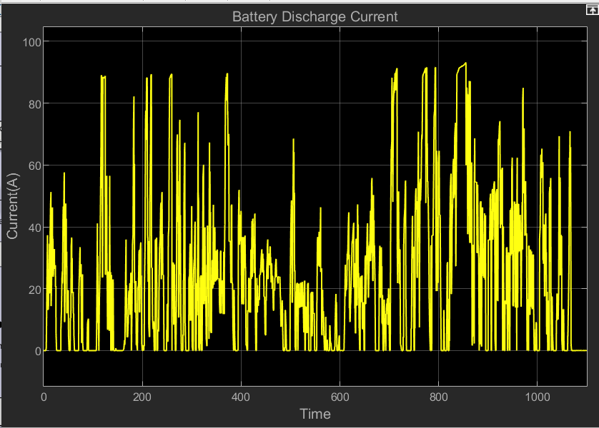
Battery current for different drive cycle
NEDC Drive cycle
Urban Drive Cycle
Rural Drive Cycle
120 Nm
23000W
Nominal Current = 75A
Nominal Current = 90A
Nominal Current = 55A

Slide 5
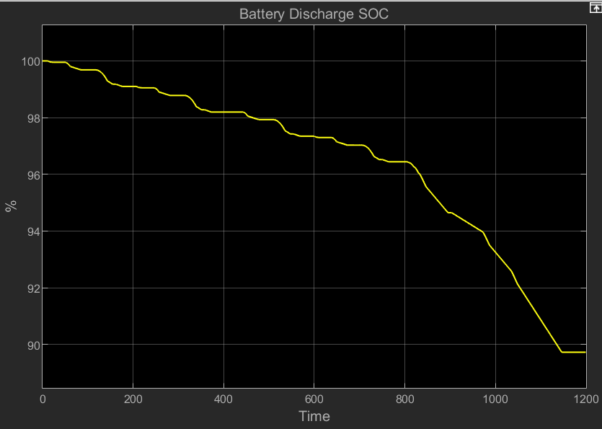
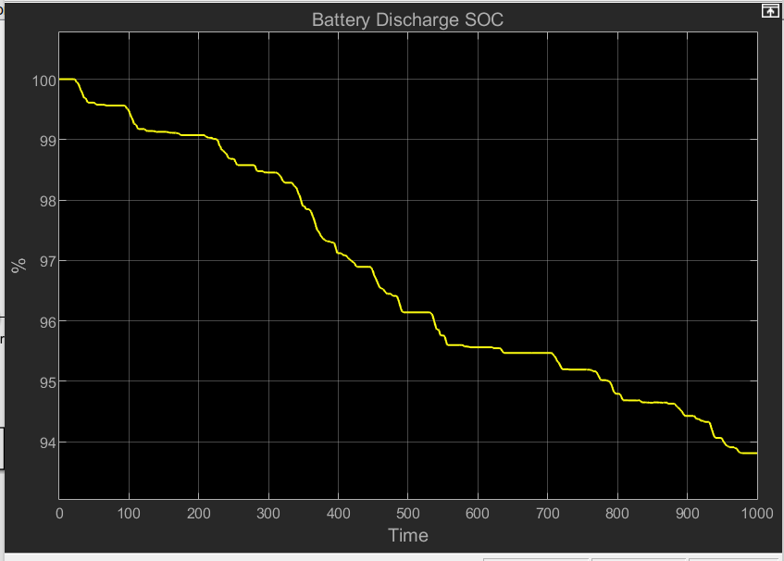
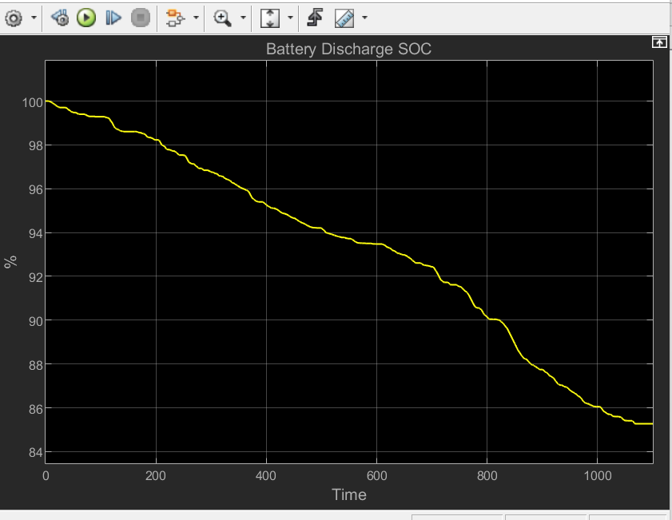
Battery SOC for different drive cycle
NEDC Drive cycle
Urban Drive Cycle
Rural Drive Cycle
120 Nm
23000W
SOC= 89%
SOC = 93.8%
SOC = 84.7%

Slide 6
Energy Consumed for different drive cycle
NEDC Drive Cycle | Urban Drive Cycle | Rural Drive Cycle
182.17 Wh/Km | 270.2 Wh/Km | 155.2Wh/Km
120 Nm

